Slide 1


dunnhumby Segmentations Overview
By Avneet
© 2018 Copyright dunnhumby / All rights reserved
customer fundamentals
Notes:
Link to dunnhumby Icon Buddy for suite of icons here: http://gb-slo-svv-0827/IconBuddy/

Slide 2
What is a segmentation in Marketing Context?
The process of grouping a market (i.e. customers) into smaller subgroups
Filters the essence out of the massive data universe
Cannot memorise everyone’s behaviour, so put them into groups
It enables:
relevant marketing to each different group
targeting and prioritization of investment
identification of sources of growth or decline
measurement of performance in different markets
We have now 18.5 M(FY16-17) customers shopping in-store and 0.3 M customers shopping Online using Clubcard

Slide 3
Segmentations try to answer questions
How does her spending compare to average
How often does she shop
How big is her shop
Which categories are popular
Looking at trends: Does she buy the same things again and again?
What items:
Value or premium
Convenience or traditional
Organic or normal
Why is she shopping at retailer X

Slide 4
What are dh Segmentations?
Segmentations are the foundations of dunnhumby’s work
Segmentation | What it helps to do
Shopping habits – know as Shopping Loyalty | Grow loyalty by: rewarding the behaviour we seek measuring success over time
Price Sensitivity | Improve focus on customer price needs
Core & Hero categories (new build) | Focus on categories important for growing Loyal customers
Basket Size & Shopping missions (new build) | Understand the primary reason for shopping trips
Full Lifestyles (new build) | Bring a range of customer needs into decision-making
Customer value based
Customer needs based

Slide 5
1. Shopping habits
- Shopping Loyalty – Visit & Spends
How do we identify our loyal and most valuable customers?
How do we measure the value of our customers?

Slide 6

Shopping habits Segmentation
Customers speak to us through their transactions – how often they shop, how much they spend, the level of their engagement with the retailer i.e. their shopping habits. These shopping habits help measure loyalty and segment customers.
Why loyalty is important to us?
Existing customers are the best customers with whom to build preference
One customer with a strong preference for your brand is typically worth at least 12 new or uncommitted customers. Committed customers:
• are your most profitable customers as they tend to buy the product at full price as well as when you reward them
• deliver a significant increase in your marketing ROI, often as much as six times the uplift per dollar spent, compared to the money invested in offers to uncommitted customers
That’s why the big wins for brands don’t lie in acquisition, but rather cementing and growing a strong preference for the brand in existing customers.
So much attention is paid to trying to gain new customers that existing customers are often side lined

Slide 7
Shopping Habit Background
Shopping Habits is a two dimensional RFM segmentation used within dunnhumby across all grocery clients.
Visit and spend patterns during an 8 week period are used to segment customers into different loyalty levels
At the highest level, we have 3 groups:
Premium + Valuable = Loyals
Potential + Uncommitted = Opportunity
Gone Away + Lapsing = Lapsed
Visit Pattern + Spend Band = Shopping Habit
Run every- week
Why 8 weeks- For most grocery clients, tracking
customers who visit in a certain week (x)
reveals that 90%-98% of them return to
the store between weeks x+1 and x+8 - long enough period to
ascertain loyalty in the grocery domain

Slide 8
Metrices used in Shopping Habit
Number of weeks shopped (Discrete values from 0 to 8) - Visit Pattern
Shopping period (Stretches of continuous (weekly) visits) - Visit Pattern
Example: If number of weeks shopped = 4 and shopping periods = 4, this indicates a customer who visited every other week during the 8 week period
Max. consecutive weeks (MCW) - Visit Pattern
Average visits per week – Visit Pattern
Median spend per week- Spend Pattern-- Customers are split into three spend bands ( High, Medium, Low) based on the median value of their total weekly spend during each week of the 8 week period. The percentile distribution of median spends helps identify the cutoffs for the high and low spend bands. Typically spend values (rounded) at 33rd and 66th percentile are used to set these cutoffs

Slide 9
Insights in Tesco UK for Shopping Habits
Shopping Loyal are those that visit regularly and spend a lot when they visit. In the U.K., Loyal customers are 1/3 of Clubcard customers but create ¾ of Clubcard sales
A Loyal Tesco customer is one who will…
Spend £35+ a week for every week shopped and visit at least six out of every eight weeks
Spend £60+ a week for every week shopped and visit at least two out of every eight weeks

Slide 10
Visit pattern gives us a better indication of shopping behaviour than number of visits
customer fundamentals
All customers
Gone away
Not shopped for 8 weeks
Yes
Not shopped for 6 weeks
Yes
Lapsing/
Recent left
Less frequent shoppers
Regular shoppers
Once
Hardly ever
Now & then
Stop Start
Weekly
Twice weekly
Once-These customers make fewer shops or have no regular pattern
Most ‘Hardly Ever’ shoppers have made just 2 visits
‘ ‘Now & then’ shoppers visit 3 or 4 weeks, spread over the 8 week period
Stop Start’ shoppers have missed 2-4 weeks out of 8 but tend to shop consecutive weeks
Visited at 7 out of 8 weeks or 6 weeks in a row
There are the most consistent customers
The final segment is based on how many times they shop per week

Slide 11
Shopping Habits helps us to focus on growing Loyal customers
Why update this?
- dunnumby’s updated methodology gives a better indication of shopper loyalty
- It takes into account visit pattern rather than simply number of visits

Slide 12
The top 32%* of customers account for 68% of sales (old data)
% of customers
% sales
Loyals
Premium
8%
30%
Valuable
24%
38%
Opportunity
Potential
29%
22%
Uncommitted
30%
7%
Lapsing-
Recent Left
3%
9%
Goneaway
Taking care of existing Loyals and encouraging loyalty amongst Opportunity customers is a recipe for success

Slide 13
1.1 Shopping habits
- Shopping Loyalty – SOS
How do we identify our loyal and most valuable customers?
How do we measure the value of our customers?

Slide 14
The SOS model determines a customer’s headroom, by calculating a customer’s Tesco grocery spend, as a % of their total grocery spend over 13 weeks
Loyal Customers
No room to stretch
Most Valuable
Premium (60%+ share of spend)
Opportunity Customers
Standard (30-60% share of spend)
Potential (10-30% share of spend)
Uncommitted (<10%+ share of spend)
Least Valuable
Unlikely to redeem

Slide 15
We don’t target Premiums as they are very loyal and don’t have much available spend to switch. There are also better suited propositions for this audience
Most Valuable
Premium (60%+ share of spend)
Standard (30-60% share of spend)
As of June 2015, we stopped targeting these more loyal customers, to ensure we were adhering to the Value proposition work and “were on the side of the customer.” However, in recent weeks, there has been a U-turn on this decision due to LFL trade gaps and we are now including them in activity in the run up to Christmas
Potential (10-30% share of spend)
Least Valuable
Uncommitted (<10%+ share of spend)
Both Potential and Uncommitted customers have the highest SCR, because they have the most headroom to switch spend - they are spending less at Tesco in the first place

Slide 16

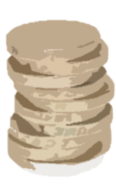
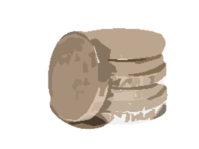


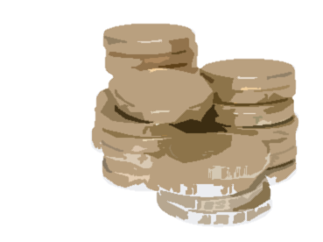


An example of SOS in practice….
Tom
£120 Total Requirement
£40 Tesco Spend
Tom SOS
Most Valuable
= £40 / £120
= 33%
Standard (30-60% SOS)
Single Household
Sandy
£340 Total Requirement
£40 Tesco Spend
Rachel SOS
Potential (10-30% SOS)
= £40 / £340
= 11%
Least Valuable
Family of 4
The SOS cell is not dependant on the value of spend, it’s the % of your total grocery spend that’s important

Slide 17
2. Price Sensitivity
-3 Level Customer Lifestyles
How do we meet our customers’ needs?
How do identify which customers are more sensitive to price and which customers are more sensitive to quality?

Slide 18
Customers speak to us through their transactions – which products they’re buying most – high price or low price products
There are currently 2 types of Price Sensitivity
segmentation
• Basket Price Sensitivity
• Customer Price Sensitivity
Customers or baskets are classified into the
following 3 groups by analysing the proportion of
high and low end products bought
PS - Price sensitive. MM - Mid Market
UM - Up market
There are 3 steps to creating price sensitivity
Create a short list of seed products of 150-300 nos.
Having both HE & LE product group across core categories
2) Create a bigger list by using triangulation to
flag products as High end or Low end
3) Score customers using the above product list
and create segments
Range/Choice
Service
Store Ambience
Upmarket Customers
Quality of Product
Mid-Market Customers
Value
Convenience
Price Sensitive/Less
Affluent Customers
PRICE
Competitive pricing on products popular amongst LA customers.
Ranging/Quality for products popular amongst UM customers.
Value and convenience is important to MM customers.
Stores can be segmented as LA/MM/UM and store strategies will vary accordingly.

Slide 19
“Product Triangulation” is a very powerful way of flagging product dimensions
The process starts with several seed items, available in most stores
Products are scored (Triangulation scores) according to
their association with all the seed items.
The top items/products are associated with all of the seeds, not just one.
Each product is assigned a highend
(HE) rank and a low-end (LE) rank based on degree of
association with HE and LE seed products
A good seed list will create HE and LE ranks that have strong
negative correlation; i.e. a product high on the LE rank will
be low on the HE rank and vice versa.
Item 2
Seed 1
Seed 3
Seed 2
Item 3
Seed 4
Seed 5
Item 1
Product A association ratio
Penetration of product A into seed product buyers
Penetration of product A into customer base
X 100
=
Notes:
Bullet slide
This will be one of the most commonly used slides.
Replace the existing text contents by highlighting and typing over.
Use the promote and demote buttons on the toolbar to change between level settings and bullets automatically
If all your information will not fit onto the slide, challenge its length or run onto two slides using the same slide title followed by: - continued.
dunnhumby story and image panel
On all slides a section has been created on the right to accommodate images and quotes. Different examples of these are shown throughout the template.
dunnhumby story and image boxes are at the end of the template, preformatted so you can copy and paste them on to your slides when appropriate.
If you are using a quote without a picture do not use a box (see Multiple bullet level slide for an example).
Information in the main section of the slide should not extend into the imagery and facts section.

Slide 20
Flagging Customers using Products
Count Product Hits in customer baskets to score customers.
Calculate Dimension Score:
Low price dimension score = low price products / total products
High price dimension score = high price products / total products
Hits are used to calculate dimension score
Calculate Difference:
Difference = (High price dimension score - Low price dimension score)
Rank customers in order of this difference and use cut-offs to segment as PS/MM/UM.

Slide 21
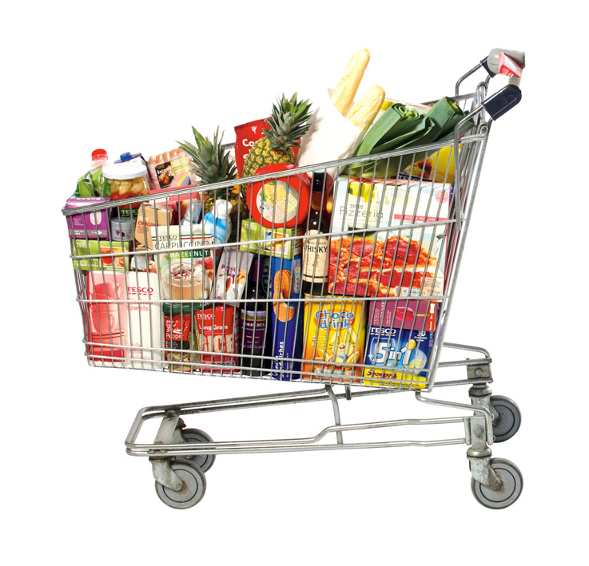
Classify as many Products in Store as Possible
Start with a small list
“Seed List”
Low End – High End products
Get a bigger list
“Triangulation list”
Low End – High End products
Look in to baskets for products bought along

Slide 22
Classify Customers
UM
> 20%
% of HE items - % LE items
MM
< -17%
LA
Notes:
Unclassified customers

Slide 23
You Are What You Buy
Most of the products in your basket are
“Low End”
Low Affluence (LA)
If one is neither
UM or LA
then
“Mid market”
Most of the products in your basket are
“High End”
Up Market (UM)
So, we should know which products are Low End and which are High End

Slide 24
2.1 Price Sensitivity
-Store Level Segmentation
How do we meet our customers’ needs?
How do identify which customers are more sensitive to price and which customers are more sensitive to quality?

Slide 25
Price Sensitivity can be used to create a store segmentation
Midmarket stores
Number of stores
Upmarket stores
Price Sensitive stores
% of Price Sensitive baskets
Store segments can help to think about the right actions for the right stores (e.g. stronger promotions in PS stores)
However, the same segment may not be appropriate for every action (one size / segmentation does not always fit all)
Notes:
Stores indexed against the base line

Slide 26
Read it your self, Later.
2.3 Price Sensitivity
-Product Appeal
Are all products important to all customer groups?
How do we devise strategies relevant to different customer segments?”

Slide 27
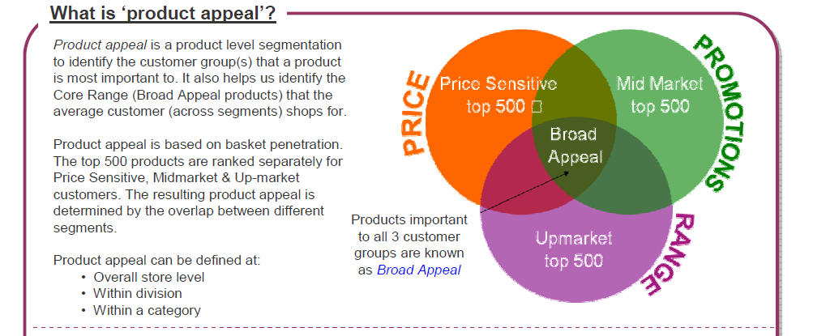
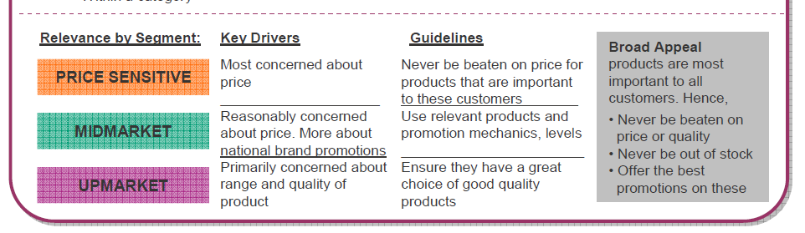
Read it your self, Later.

Slide 28
… and a basic product segmentation
Read it your self, Later.
Product level segmentation to identify what products are important to different segment of customers
Based on the basket penetration for each price sensitivity segment, identify the top 500 products for that segment
We have 7 different segments (based on the overlap between different segments)
PS top 500
PS & MM
MM top 500
Broad Appeal
PS & UM
MM & UM
UM top 500

Slide 29
… and a basic product segmentation
Price Sensitivity automatically creates a classification of products based on their appeal to different segments
Read it your self, Later.
UM top 500
MM top 500
80%
80%
60%
60%
% Product Sales
% Product Sales
40%
40%
20%
20%
0%
0%
PS
MM
UM
PS
MM
UM
Price Sensitivity Segment
Price Sensitivity Segment
PS top 500
Broad Appeal
80%
80%
60%
60%
% Product Sales
% Product Sales
40%
40%
20%
20%
0%
0%
PS
MM
UM
PS
MM
UM
Price Sensitivity Segment
Price Sensitivity Segment

Slide 30
The most important use of Price Sensitivity is to create a Customer Led pricing model
Read it your self, Later.
Invest on products bought by the most price-sensitive customers
Ideal curve
Typical price-matching
Index v/s Competition
Rank by PS basket penetration
Products bought by: most price-sensitive customers … … least price-sensitive customers

Slide 31
customer Lifestyles is a language designed by dunnhumby and Tesco to help describe how customers shop. It is a behavioural segmentation based on the concept that “You are what you buy/eat” to help both Tesco and suppliers ensure they appeal to all customer types and target marketing at the right areas.
How can Customer Lifestyles be used?
Commercial: Lifestyles are integral to Commercial ranging decisions, ensuring that ranges appeal to all customers and that differentiated ranges are developed where required.
Clubcard: Lifestyles are used to target Clubcard trade-drivers that ensure customers receive relevant communications and coupons.
Brand Comms: Lifestyles are used to understand the profile of customers who purchase featured products and the media they consume, in order to enhance media planning and optimise media spend.
Local: Lifestyles are an integral part of the ‘Share of Spend’ tool which is widely used to counteract competitor store impacts.

Slide 32
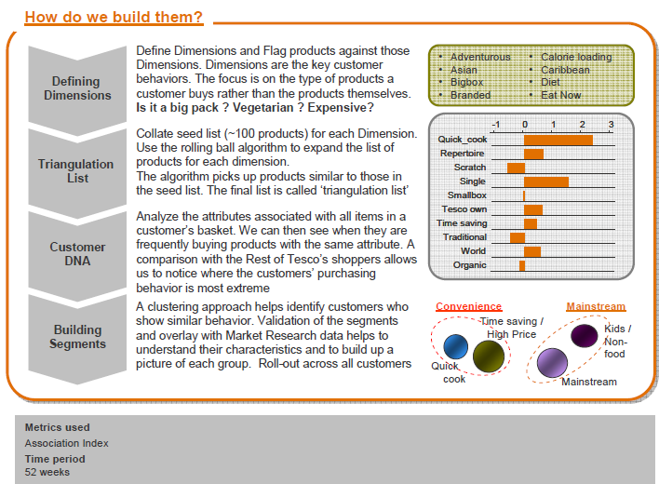
Customers are scored on a variety of dimensions
that describe aspects of their needs and wants.
Using these dimensions.
we can describe a given customer’s “DNA”,
i.e. a series of scores that describe
the main themes and characteristics
of their shopping behavior.

Slide 33
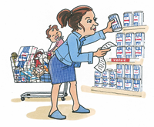
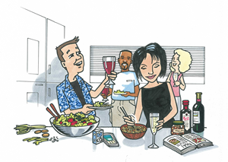
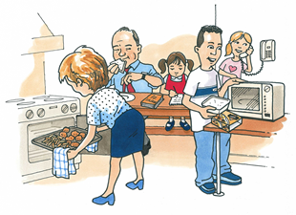
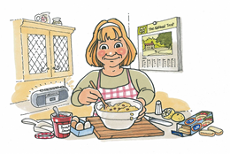
Price Sensitivity is also the first step towards a fuller understanding customer needs
I have to stick to a budget
I love exotic and adventurous food
The microwave is a godsend for me!
I love baking on a Sunday afternoon

Slide 34
To do this we need to create a complete customer DNA
4
Mr. A Smith – London
3
2
1
0
-1
-2
-3
-4
Asian
Atkins
Baby
Bulk
Ethnic
Dieting
Elderly
Healthy
Kosher
Organic
Gourmet
Snacking
Buying Big
Hispanic
Kids Choice
Meat Eaters
Price Overall
Traditional
Promo Prop
Repertoire
Home Baking
Brand Loyalty
African American
Calorie Loaders
Home Cooking
No Time to Cook
Pantry Loaders
Vegetarian
Coupon Usage
Disposable Goods

Slide 35
2.1.1 Price Sensitivity
-3 Level Customer Lifestyles
How do we meet our customers’ needs?
How do identify which customers are more sensitive to price and which customers are more sensitive to quality?

Slide 36
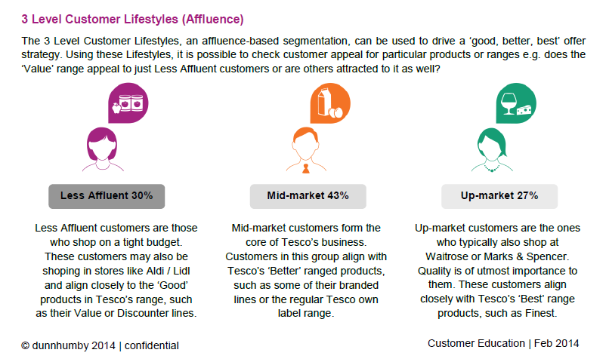
Insight- Tesco UK – 3 level customer Lifestyle

Slide 37
2.1.2. Price Sensitivity
-6 Level Customer Lifestyles (Detailed)
How do we meet our customers’ needs?
They can be used to ensure that a category’s overall attractiveness remains high, to understand a brand’s appeal better or to target specific customers with Clubcard communications and promotions.

Slide 38
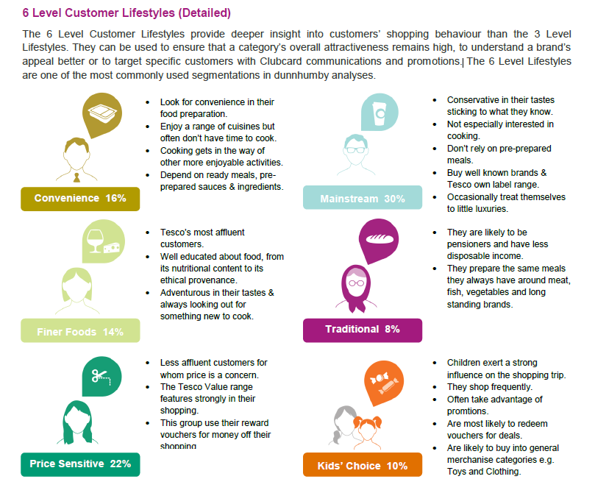
Insight- Tesco UK – 6 level customer Lifestyle

Slide 39
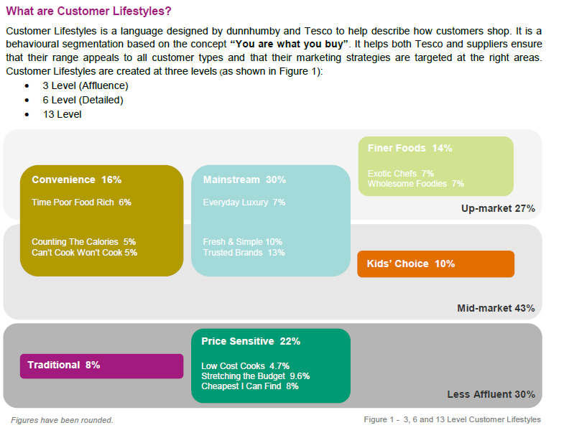
Tesco lifestyles – split into 18 low level segments

Slide 40
Read it your self, Later.
13 Level Customer Lifestyles
The 13 Level Customer Lifestyles are used when more detailed insight on customer behaviour is required, for example to target specific types of customers e.g. health conscious, ethical etc.

Slide 41
3. LIFESTAGE
- Based on shopper’s age and family composition

Slide 42
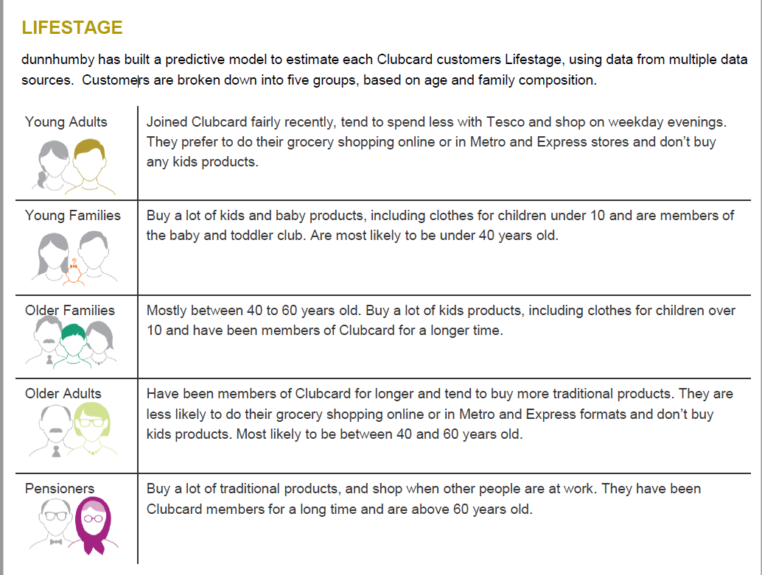
Young Adults are more likely to be from the Convenience, Finer Foods or Mainstream Lifestyles. They are unlikely to be price sensitive with over 50% earning a medium income of between £10,000 - £30,000 pa.
Young Families are more likely to be from the Kids’ Choice Lifestyle and have a high income of over £30,000 pa. They prefer to do their grocery shopping online or in an Extra store.
Older Families are more likely to be from the Kids’ Choice or Convenience Lifestyle and have a high income of over £30,000 pa. They prefer to do their grocery shopping online or in an Extra
Older Adults are more likely to be from the Finer Foods Lifestyle and earn a high income of over £30,000 pa. They also have a greater involvement with Tesco Retailing Services brands.
Pensioners are more likely to be from the Traditional Lifestyle and earn a low income of less than £10,000 pa. They prefer Metro and Superstore formats and are less likely to shop online.

Slide 43
4. TESCO FIVE FAMILIES- Important segment

Slide 44
TESCO FAMILY
Roshni (pre-family)
25% of customers
17% of spend
Convenience shopping to fit in with her busy life; Roshni shops smaller formats and smaller baskets. She is unlikely to be Loyal and less likely to engage with wider business brands or coupons.
Dawn (high affluence, post-family)
28% customers
30% spend
A healthy diet and quality foods are important to Dawn who likes to cook from scratch. Likely to be Loyal; redeems coupons, and points on Boost Partners. Has headroom to spend more at Tesco.
The Wicks (low affluence, family)
16% of customers
18% of spend
Driven by price but the influence of their children makes them more impulsive; shops big and small baskets. Likes Boost and Orchard, and will spend on GM. The least healthy Family.
Clubcard Customers:
Carol (low affluence, post-family)
19% of customers
17% spend
Shops smaller baskets from her local store; likely to buy more ’traditional’ products and considers price. Redeems coupons and her points at Face Value. Unlikely to use or rely on technology
The Mayers (high affluence, family)
12% of customers
18% of spend
Full Shop at Tesco instore or online; the most likely Family to be Loyal. Eat meals as a family, and will spend more to ensure quality. Boosts their points, shops GM, and a quarter have a Tesco Bank product.

Slide 45
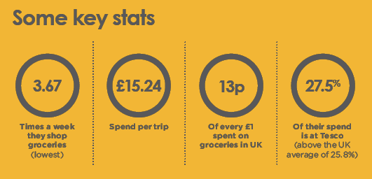
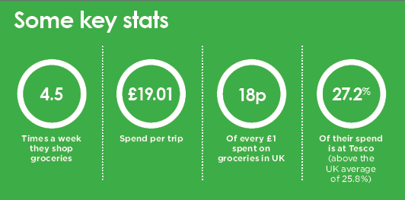
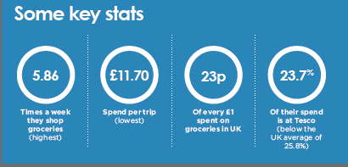
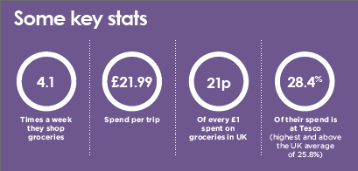
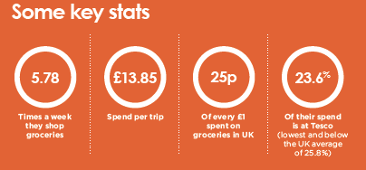
Read it your self, Later.
Roshni | The Wicks
The Mayars | Carol
Dawn

Slide 46
5. Basket-Size
&
Shopping Missions
What is the specific ‘motivation’ behind the customer visit?
What is the primary reason for a shopping trip/basket?

Slide 47
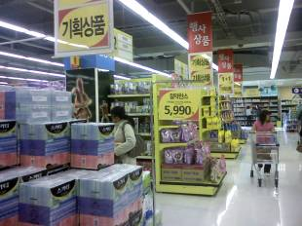
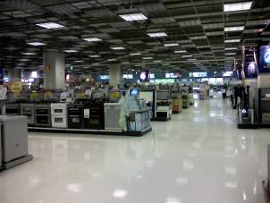
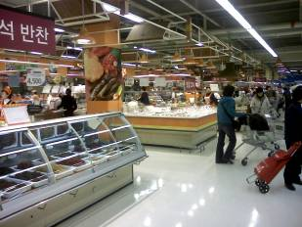
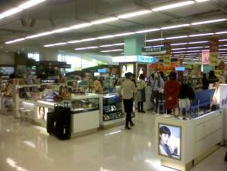
Shopping Missions is another segmentation of customer needs
What is the ‘primary need’ behind a customer’s?

Slide 48
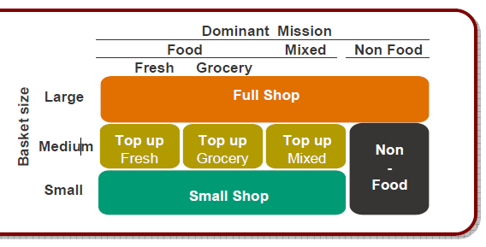
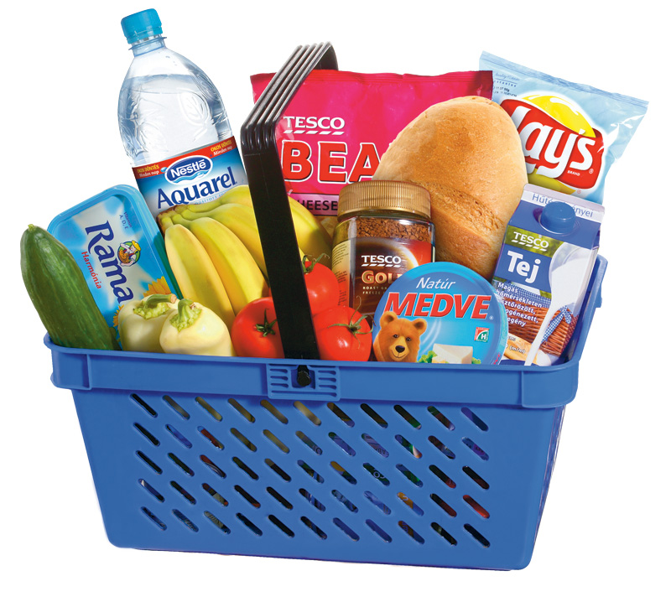
Where we only have EPOS data, we will focus on basket size instead
Basket Size - classifies baskets based on the breadth (number of categories shopped) and depth (number of unique items bought).
the dominant mission type
(food, non-food, fresh, grocery) and also
- the basket size
(full shop, top-up shop, small shop)
Small
Baskets that only include a few categories and a small number of unique items
Medium – Top Up
Baskets that have more items and categories than a Small shop but do not have the breadth and depth of a Large shop
Large – Full Shop
Baskets that contain a large number of unique items from a wide range of categories
vs
Notes:
Measure Kroger’s success – 7.4% increase on Loyal customers. 5% more sales for Loyal customers in 2005 vs. year ago
Reward programs target loyal customers – LCM, themed events
Measure success of loyalty programs - %loyal customers engaged, % increase on loyalty after engagement
Product assortment – de-list items that are less important to loyal customers
Shop – profiling product buyers, custom panels
All other analysis

Slide 49
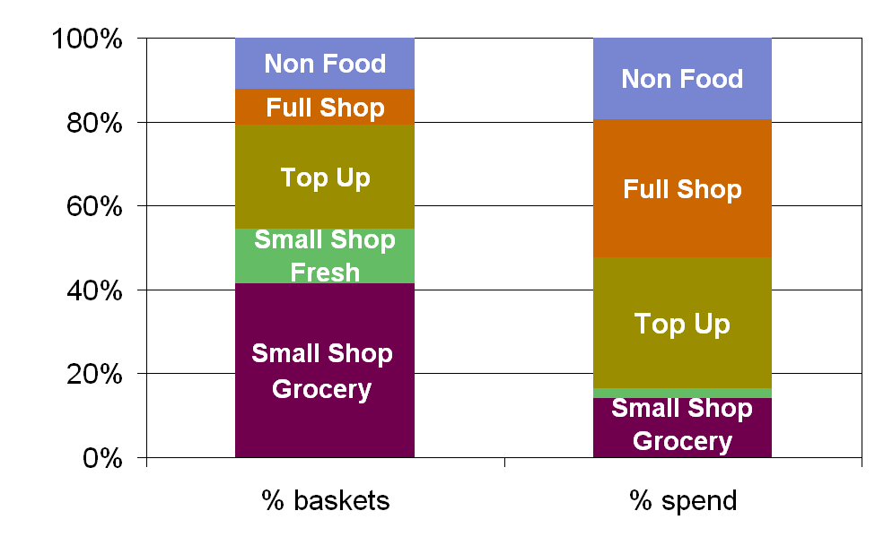
In some retailers, we choose to split out Small Shop missions because of the high % of Small Shops
We can understand the reasons customers visit retailer’s stores (an extension of basket size)

Slide 50
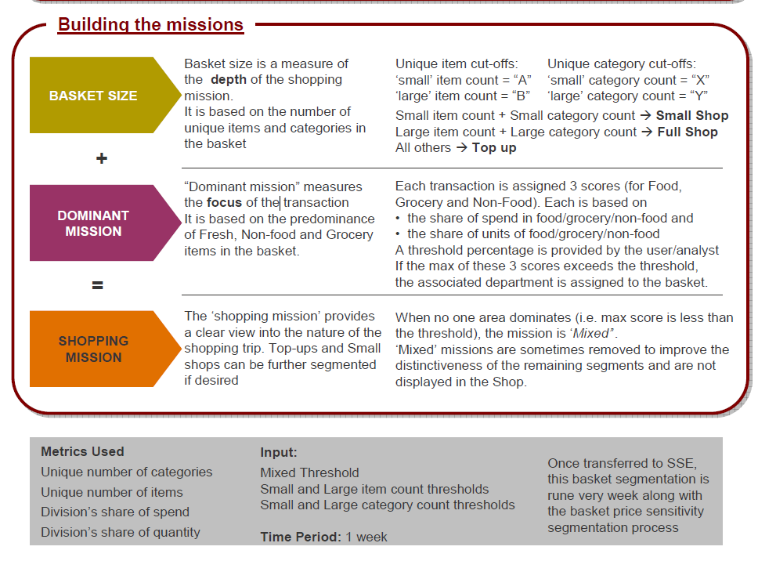
Read it your self, Later.

Slide 51
6. Preferred Store
- Clubcard customer only
“Customers can shop across multiple stores. How do I target them with the right offers?
Which store-specific offer should they receive?
Also, how do I determine the profile of a store?

Slide 52
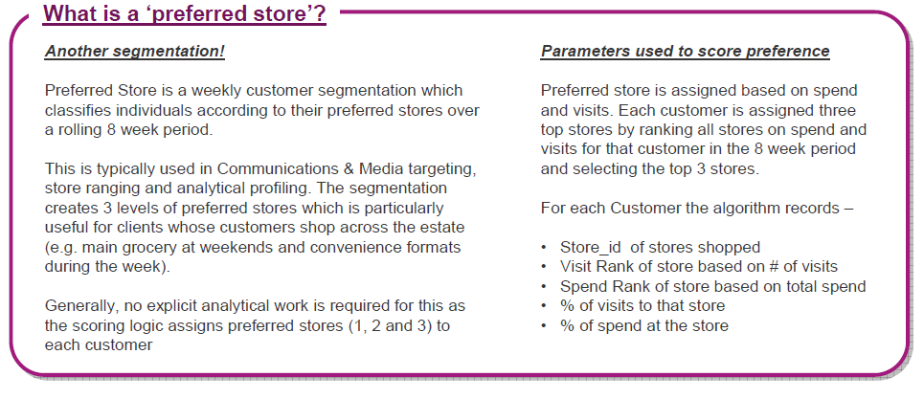
Preferred store tracks customers’ main store
Preferred store is a simple customer summary based on spend and visits. It works either on 13 or 8 weeks.
Each customer is assigned three top stores based on his spend and visits. The program basically ranks all stores on spend and visits for each customer and then uses these rank to find three top stores.
Preferred store can be used for campaigns

Slide 53
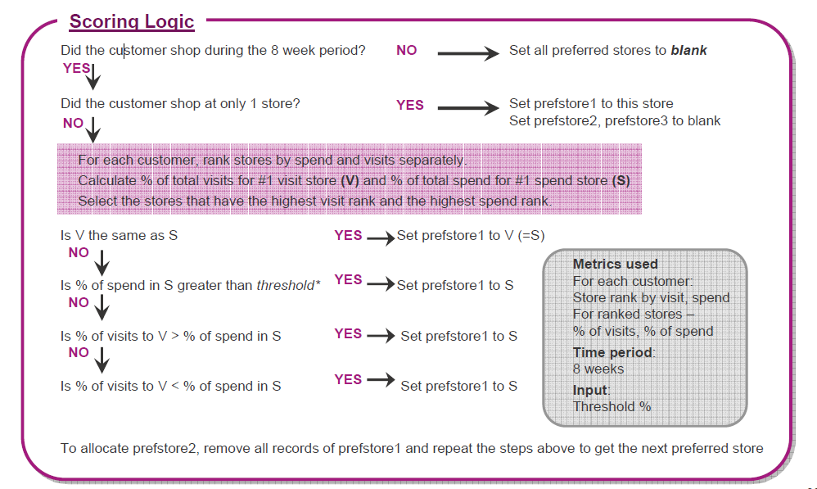
Read it your self, Later.

Slide 54
APPENDIX

Slide 55
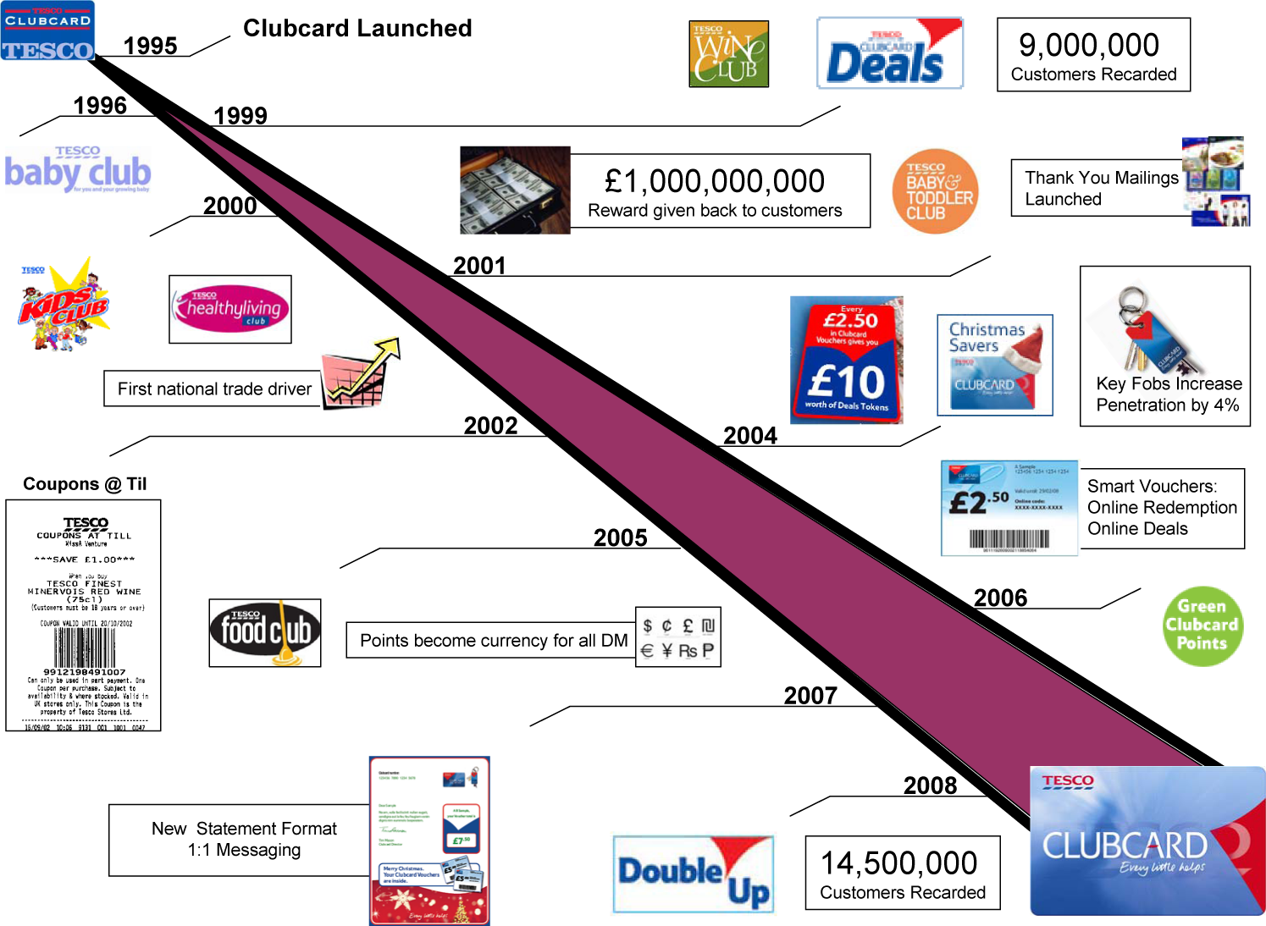
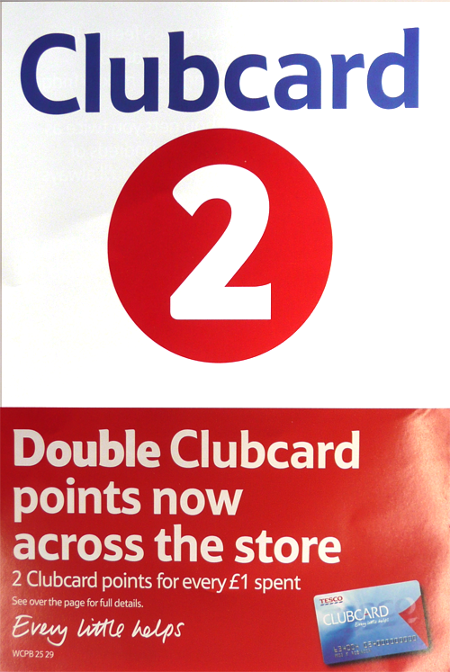
evolve the Tesco loyalty program
2009
We have now 18.5 M(FY16-17) customers shopping in-store and 0.3 M customers shopping Online using Clubcard

Slide 56

Tesco overall sales grew by 0.4 % driven solely by Non Club Card Sales
Total Sales
This Year | £ 46.7 BN
YoY Change | + 0.4 %
Contribution | + £ 182 M
CC Sales
This Year | £ 29.9 BN
YoY Change | - 3.5 %
Contribution | - £ 1.1 BN
Non CC Sales
This Year | £ 16.8 BN
YoY Change | + 8.4 %
Contribution | + £ 1.3 BN
Customers
This Year | 18.8 M
% Change | - 2.2 %
Contribution | - £ 0.7 BN
Spend per Customer
This Year | £ 1,588.9
% Change | - 1.3 %
Contribution | - £ 0.4 BN
Visits
This Year | 1.7 BN
YoY Change | + 7.2%
Contribution | + £1.1 BN
Spend per Visit
This Year | £ 10
YoY Change | + 1.1 %
Contribution | + £ 0.2 BN
Visit per Customer
This Year | 59.6
YoY Change | - 2.0 %
Contribution | - £ 0.6 BN
Spend per Visit
This Year | £ 26.7
YoY Change | + 0.7 %
Contribution | + £ 0.2 BN
Unit per Visit
This Year | 4.6
YoY Change | + 2.6 %
Contribution | + £ 0.4 BN
Spend per Unit
This Year | £ 2.2
YoY Change | -1.3 %
Contribution | - £ 0.2 BN
Unit per Visit
This Year | 13.5
YoY Change | + 1.8 %
Contribution | + £ 0.5 BN
Spend per Unit
This Year | £ 2
YoY Change | -1.1 %
Contribution | - £ 0.3 BN
64%- Tesco Clubcard penetration in term of Sales but over time it is declining
Note: CC Sales– Clubcard Sales
Non CC Sales– Non Clubcard Sales
*Data Analysis is performed on 100% Tesco transactions data for two continuous years on the basis of YoY change
Previous year : 02-March-2015 to 28-Feburary-2016
Current year : 29-Feburary-2016 to 27-Feburary-2017
Notes:
Overall Sales increased by 0.4%
CC sales decline due to lose in club card customers and visit per customers

Slide 57
We identify an individual’s affluence based on a number of variables
Affluence is determined from a combination of the following:
It’s based on best practice from financial services industry
For GM we use a 5 level model:
Very High, High, Mid, Low, Very Low
Tesco attracts customers from all affluence levels
Having a well structured “good / better / best” offer is key
Income
Property Value
Council Tax
CCJs
Outstanding Mortgage
Directorships
FSS Propensities
Notes:
“Affluence means more than income. It combines XXX”
Experian weights and standardised the input variables to create a blended ‘score’ at person level
The score is then ranked and banded into 20 bands (which is averaged out at household level) which we then combine into 5 levels (each of about equal size).
Tesco has broad appeal – Their strategy in food has always been “Winning from the Middle”.
Hence we see a cross section of customers from the UK going into stores and shopping GM.
Tesco strategy is to appeal to all levels of affluence:
For food this meant developing Value / Standard / Finest
In GM it means offering Good / Better / Best

Slide 58

Guess the annual household income for...
Very Low affluence household income, often including pensioners and people on benefits
£10k
An average household income
£30k
A Very High affluence household income
£50k
Notes:
“Guess the average household affluences”.
Click for the answer after each one after asking delegates to guess.
As we already mentioned, Household scores for affluence are based on multiple metrics, of which income is only 1 of those metrics.
These were researched a few years ago but when went to refresh learnt that GDP per capita is now same as pre-financial crisis – we’re not getting wealthier
For example we tend to up-weight pensioners who have a low income but higher housing wealth.
The 50K affluence may have more than one earner in the house.
Keep in mind that because clubcards are attached to a household – these figures relate to more than one earner
Higher affluence in the S.E
If you think about that yearly spend – 1800 in grocery and 200 in GM – quite a bit chunk

Slide 59
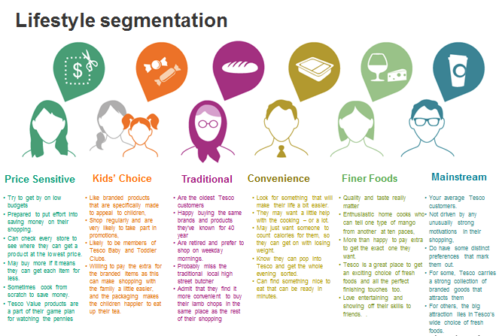
Glossary

Slide 60
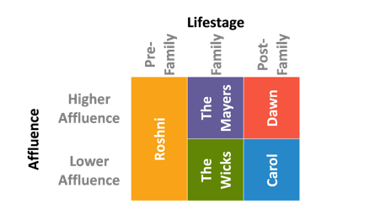
Glossary
Back
Five Families

